Slide 1



2nd Place Solution Learning Equality Challenge
Konrad Habel
Notes:
Recommending picking out he most interesting and important parts from your documentation.

Slide 2
Agenda

Slide 3
Agenda
Background
Approach
Language Switching
Knowledge Distillation
Quantization
Dynamic Threshold
Results
Important and Interesting Findings
Question and Answer

Slide 4
Background

Slide 5
Background
Ph.D. student at the University of the Bundeswehr Munich in Germany
German diploma in Automotive Engineering
Bachelor of Science (B.Sc.) in Business & Information Systems Engineering
Master of Science (M.Sc.) in Computer Science

Slide 6
Approach

Slide 7
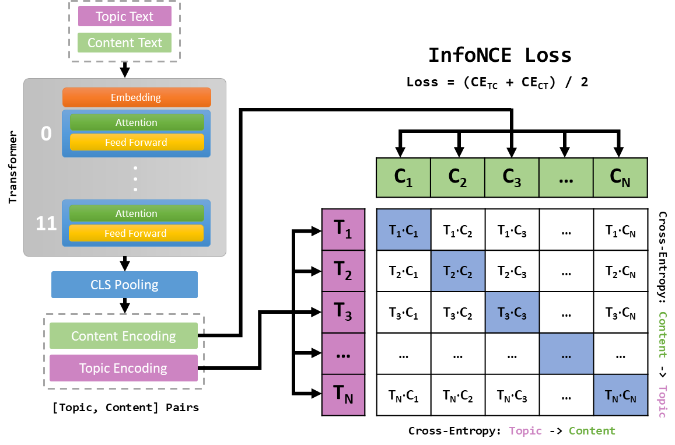
Approach
Solution is a single stage approach based on cosine similarity for retrieval using the InfoNCE loss as training objective.

Slide 8
Input
Input Data: No use of special token for separation instead, the # is used as separator.
Topic: Title # Topic-Tree # Description
The topic tree is reverse ordered and the same separator # is used:
-> Title # Parent # Grandparent # ... # Description
Content: Title # Description # Text (cut to 32 based on white space splitting)
If for example the Description is empty the model will see as input:
-> Title # # Text
For both Topic and Content a maximum sequence length of 96 tokens is used.

Slide 9
Language Switching

Slide 10
Language Switching
Translation of the most common languages en, es, pt, fr into each other for additional training data.
. . .
0: original
E1:0
E2:1
E35:0
1: en <-> fr and es <-> pt
E3:0
E36:0
2: en <-> es and fr <-> pt
E4:2
E37:0
E5:0
E38:0
2: en <-> pt and fr <-> es
E6:3
E39:0
. . .
E40:0

Slide 11
Knowledge Distillation

Slide 12
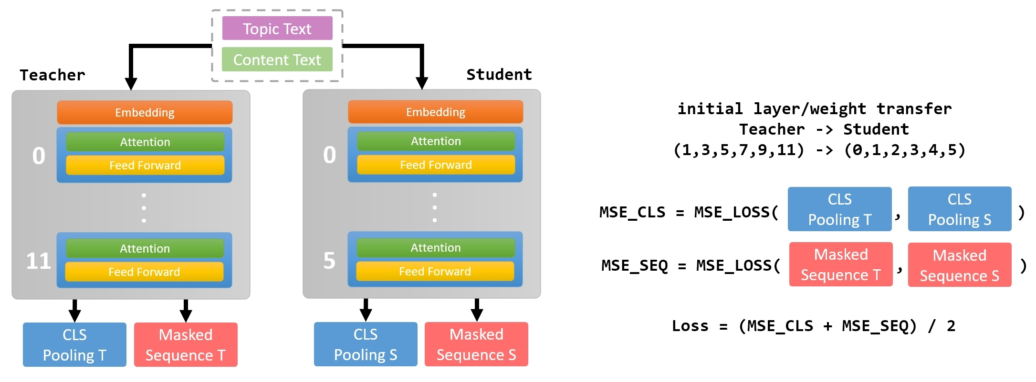
Features Selection/Engineering
Knowledge Distillation
Variable Importance Plot
Distillation from 12 -> 6 Layers used for the Efficiency Prize

Slide 13
Quantization

Slide 14
Features Selection/Engineering
Quantization
Variable Importance Plot
Using Pytorch “Post Training Dynamic Quantization” for the Efficiency Prize
Embedding
Pytorch
Post Training Dynamic Quantization
0
Attention
Feed Forward
torch.float16
. . .
torch.qint8
5
Attention
torch.float16
Feed Forward

Slide 15
Dynamic Threshold

Slide 16
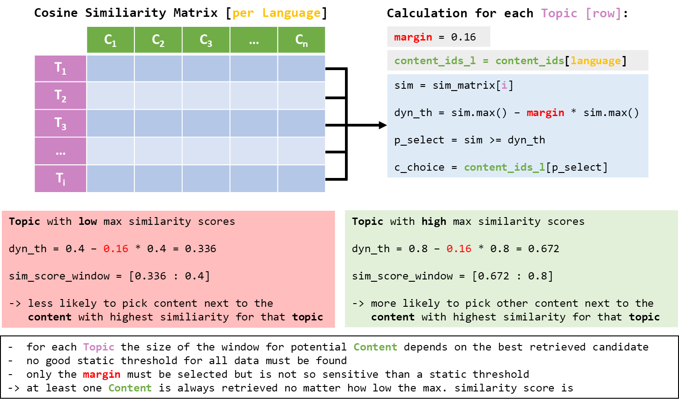
Features Selection/Engineering
Dynamic Threshold
Variable Importance Plot

Slide 17
Results

Slide 18
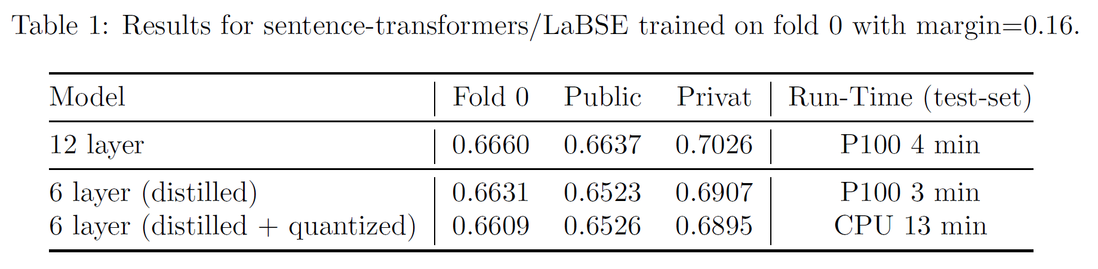
Fold 0
Influence of the distillation and quantization:
models are trained on a single RTX 3090 for 40 epochs

Slide 19
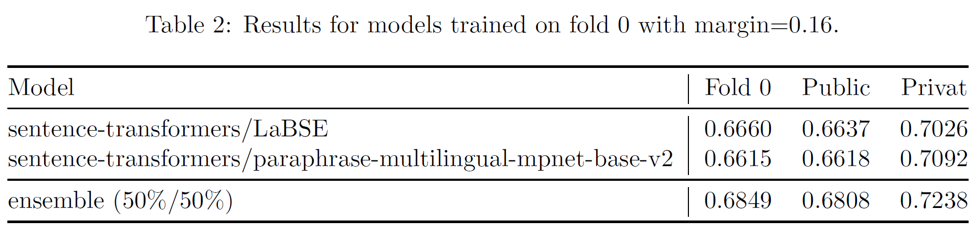
Fold 0
Combining models into an ensemble:
models are trained on a single RTX 3090 for 40 epochs

Slide 20
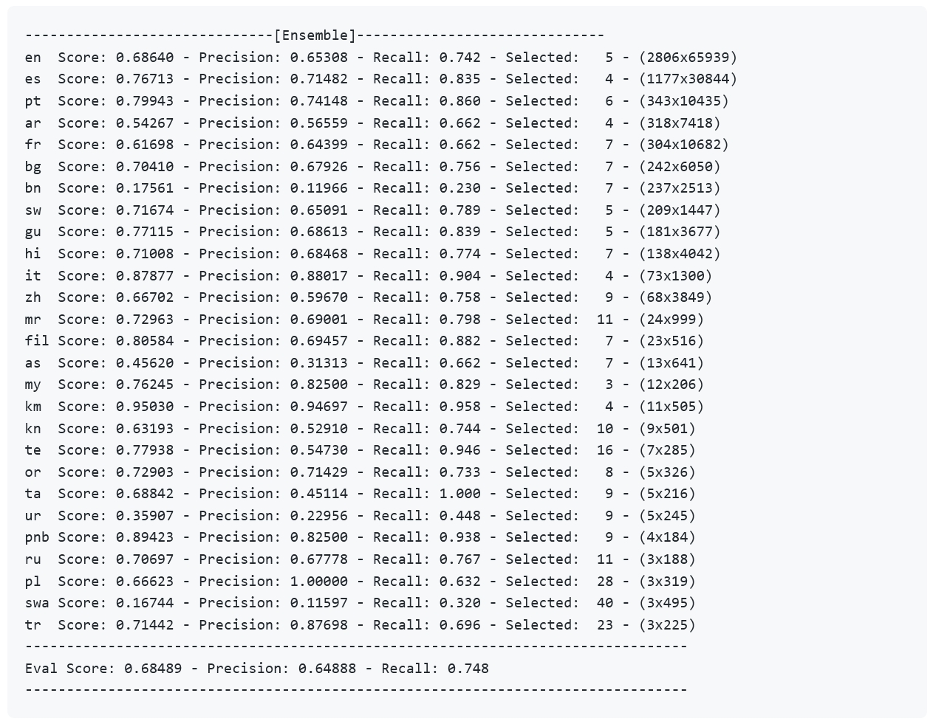
Fold 0
Results per language:

Slide 21
Trained on all data
GPU - Ensemble:
CPU - Ensemble:
Ensemble:
Num. Models: 5
Score:
Privat: 0.75479
Public: 0.70977
Inference:
Kernel: P100 - GPU
Runtime: 9 min
Max. Seq. Length: 96
Trained:
Data: all data (no folds)
Epochs: 40
Batch Size: 768 – pairs of [Topic, Content]
Seq. Length: 96
LR-Schedule: polynomial decay with warmup (2 Epoch)
Max. LR: 0.0003
LR-End: 0.0001
GPU: 4xV100 (32GB)
Models:
- 'sentence-transformers/LaBSE'
- 'facebook/mcontriever-msmarco'
- 'sentence-transformers/stsb-xlm-r-multilingual'
- 'sentence-transformers/paraphrase-multilingual-mpnet-base-v2'
- 'sentence-transformers/xlm-r-100langs-bert-base-nli-mean-tokens'
Ensemble:
Num. Models: 2
Score:
Privat: 0.73118
Public: 0.68959
Inference:
Kernel: CPU
Runtime: 23 min
Max. Seq. Length: 96
Destillation:
Teacher: pre-trained Model of GPU Submission
Layers keep: 6
Quantization: post training dynamic
Data: all data (no folds)
Epochs: 40
Batch Size: 1024 – pairs of [Topic, Content]
Seq. Length: 96
LR-Schedule: polynomial decay with warmup (2 Epoch)
Max. LR: 0.0003
LR-End: 0.0001
GPU: 4xV100 (32GB)
Models:
- 'sentence-transformers/LaBSE’
- 'sentence-transformers/paraphrase-multilingual-mpnet-base-v2'
0
5

Slide 22
Important and Interesting Findings

Slide 23
Important and Interesting Findings
Models can be trained on consumer-grade hardware like a single RTX 3090 when using gradient-checkpointing.
Contrastive training with InfoNCE works also for a n x m matching problem when carefully selecting samples for every batch -> sampling strategy plays an important role for good results.
Influence of the topic tree, maybe training models with different usage of the topic tree information could be useful.

Slide 24
Question and Answer

Slide 25


